Slide 1
MEDIA MANAGEMENT AND MARKETING

Slide 2
Content management

Slide 3
Content management
Content management (CM) is the process for collection, delivery, retrieval, governance and overall management of information in any format. The term is typically used in reference to administration of the digital content lifecycle, from creation to permanent storage or deletion. The content involved may be images, video, audio and multimedia as well as text.
*Content management practices and processes can vary by purpose and organization. This can lead to differences in steps or terminology.

Slide 4
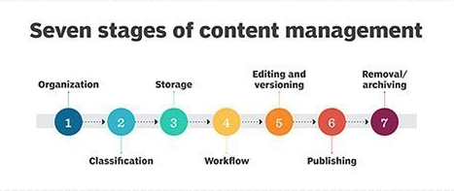

Slide 5
Content management
The stages of the content management lifecycle are:
Organization: The first stage where categories are created, taxonomies designed and classification schemes developed.
Creation: Content is classified into architectural categories.
Storage: Content format and storage decisions are made based on ease of access, delivery, security and other factors dependent on the organization's needs.
Workflow: Rules are designed to keep content moving through various roles while maintaining consistency with the organization's policies.
Editing/Versioning: This step involves managing multiple content versions and presentation changes.
Publishing: The stage where content is delivered to users, which can be defined as website visitors or internal publishing via the Intranet for employees.
Removal/Archives: The final stage where content is deleted or moved to an archive when it is infrequently accessed or obsolete.

Slide 6
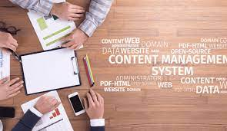
Content management

Slide 7
Content management
Content management systems and tools
In addition to content management platforms for specific content types, there are also general content management systems (CMS) which provide automated processes for collaborative digital content management and creation.
A CMS commonly includes features such as format management, publishing functionality and the ability to update content. A CMS can allow a user to create a unified look and have version control, but a downside is that it often can require specific training for content creators. A digital asset management (DAM) system is another type of CMS that manages documents, movies and other rich media assets. A few examples of notable CMSes are WordPress, Joomla, and Drupal.

